Slide 1


Nutan Maharashtra Vidya Prasarak Mandal’s
NUTAN COLLEGE OF ENGINEERING AND RESEARCH
Under Administrative Support of Pimpri Chinchwad Education Trust
ISO 21001:2018 EOMS Certified
Mini Project II Presentation
Presentation on:
Smart Industrial Machine Monitoring System(SIMMS)
By
Shruti Jadhav(38)
Arpita Phalke(43)
Kirti Rachkar(47)
Mrs. Priyanka Vyas
Guide Name
Department of Computer Science Engg - Aritificial Intelligence

Slide 2
Nutan Maharashtra Vidya Prasarak Mandal’s
NUTAN COLLEGE OF ENGINEERING AND RESEARCH
Under Administrative Support of Pimpri Chinchwad Education Trust
ISO 21001:2018 EOMS Certified
Mini Project II Presentation
Introduction:
Industries using machinery often struggle to keep them running smoothly. Traditional monitoring systems don't always provide timely updates, leading to inefficiencies and higher costs.
Smart monitoring systems use modern technology to collect real-time data. In our project, we use an Arduino Uno and Bluetooth HC-05 to connect machines to a central system. It then displays the number of completed cycles on a Bluetooth terminal and alerts operators with a buzzer when action is needed. This approach helps improve machine monitoring and overall industrial efficiency.

Slide 3
Nutan Maharashtra Vidya Prasarak Mandal’s
NUTAN COLLEGE OF ENGINEERING AND RESEARCH
Under Administrative Support of Pimpri Chinchwad Education Trust
ISO 21001:2018 EOMS Certified
Mini Project II Presentation
Problem Statement:
Industrial operations often struggle with accurately and timely monitoring of machine performance. Traditional monitoring systems lack real-time updates, leading to inefficiencies, increased maintenance costs, and unexpected downtimes.
There is a need for a reliable system that can track machine cycles accurately and alert operators immediately upon the completion of each cycle.
The Smart Industrial Machine Monitoring System aims to address these issues by using modern technology to enhance the monitoring and management of industrial machines.
In various industries such as manufacturing, textile, and food processing smart machine monitoring system will be very useful.

Slide 4
Nutan Maharashtra Vidya Prasarak Mandal’s
NUTAN COLLEGE OF ENGINEERING AND RESEARCH
Under Administrative Support of Pimpri Chinchwad Education Trust
ISO 21001:2018 EOMS Certified
Mini Project II Presentation
Objective:
Reliable Hardware Connection: Ensure all hardware components (Arduino Uno, breadboard, Bluetooth HC-05, buzzer) are correctly connected and functioning.
Accurate Cycle Tracking: Track and record the number of cycles completed by an industrial machine, with each cycle defined by a set time interval.
Buzzer Alerts System: Using a buzzer to notify operators immediately upon the completion of each machine cycle, enabling quick responses and adjustments.
Real-Time Data Display: Showing the number of completed cycles on a Bluetooth terminal, providing operators with real-time performance data.

Slide 5
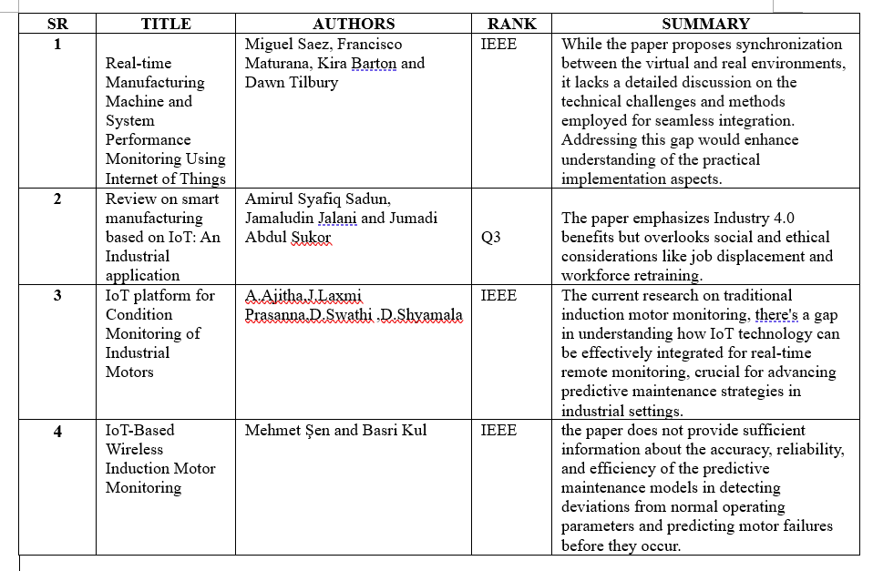
Nutan Maharashtra Vidya Prasarak Mandal’s
NUTAN COLLEGE OF ENGINEERING AND RESEARCH
Under Administrative Support of Pimpri Chinchwad Education Trust
ISO 21001:2018 EOMS Certified
Mini Project II Presentation
Literature Survey:

Slide 6
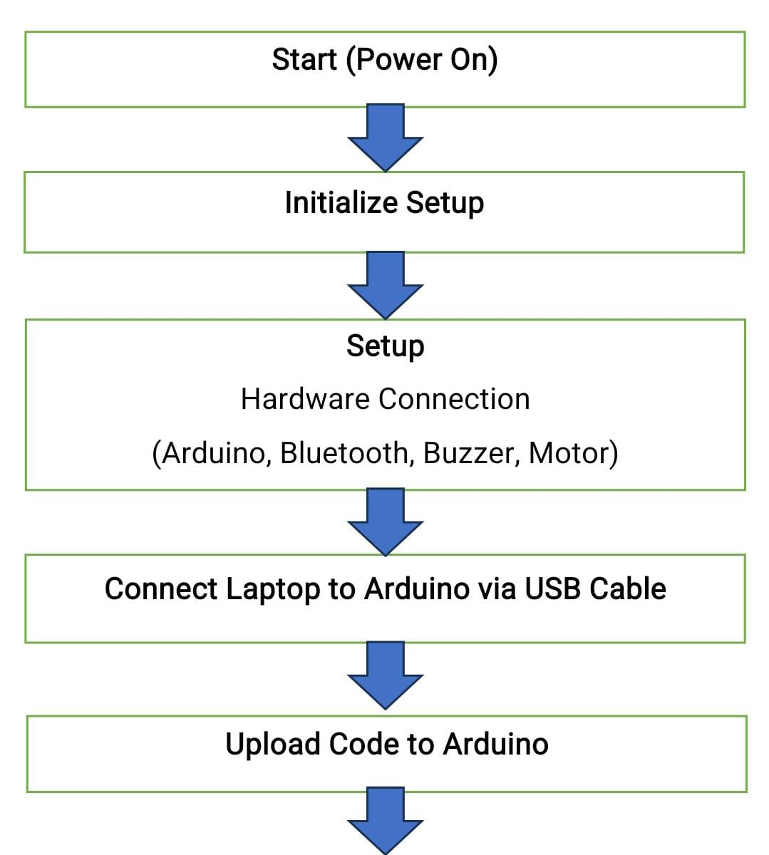
Nutan Maharashtra Vidya Prasarak Mandal’s
NUTAN COLLEGE OF ENGINEERING AND RESEARCH
Under Administrative Support of Pimpri Chinchwad Education Trust
ISO 21001:2018 EOMS Certified
Mini Project II Presentation
Methodology:

Slide 7
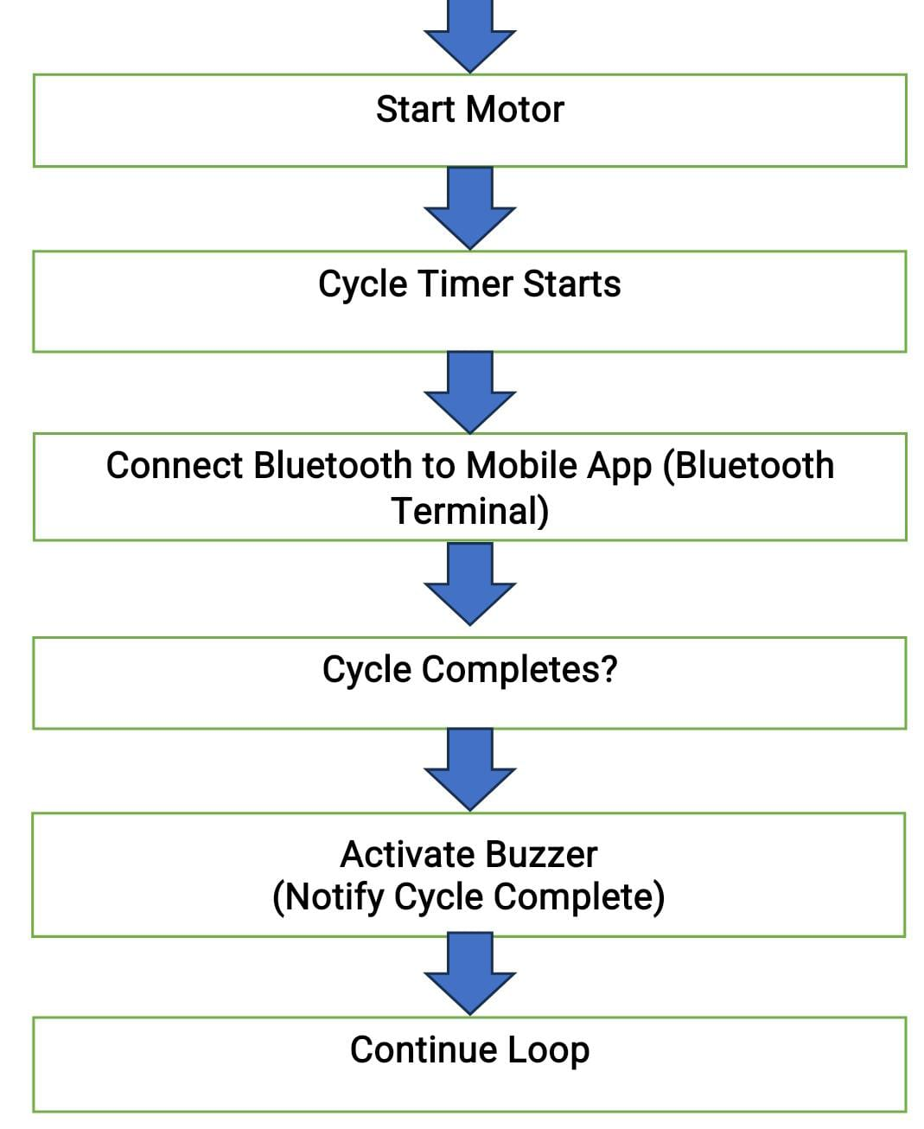
Nutan Maharashtra Vidya Prasarak Mandal’s
NUTAN COLLEGE OF ENGINEERING AND RESEARCH
Under Administrative Support of Pimpri Chinchwad Education Trust
ISO 21001:2018 EOMS Certified
Mini Project II Presentation

Slide 8
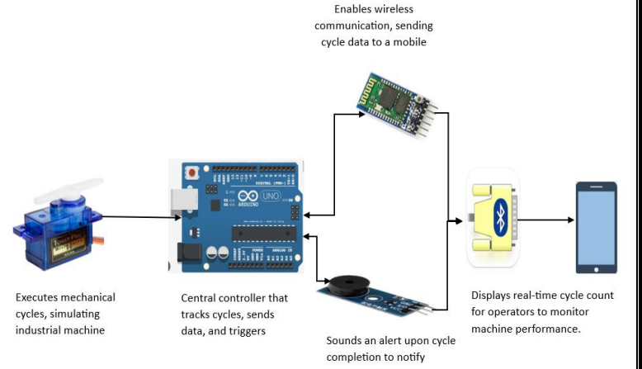
Nutan Maharashtra Vidya Prasarak Mandal’s
NUTAN COLLEGE OF ENGINEERING AND RESEARCH
Under Administrative Support of Pimpri Chinchwad Education Trust
ISO 21001:2018 EOMS Certified
Mini Project II Presentation

Slide 9
Nutan Maharashtra Vidya Prasarak Mandal’s
NUTAN COLLEGE OF ENGINEERING AND RESEARCH
Under Administrative Support of Pimpri Chinchwad Education Trust
ISO 21001:2018 EOMS Certified
Mini Project II Presentation
Hardware components:
Arduino UNO: The brain of the system, executing the code to monitor cycles, control components, and communicate data.
Servo Motor SG-90: Demonstrates mechanical movements corresponding to machine cycles.
BUZZER MODULE (5V): Alerts operators of cycle completion with sound.
Breadboard and Jumper Wires: Provide a non-permanent and flexible way to connect all electronic components.
HC-05 Bluetooth Module: Facilitates wireless communication to display cycle data on a Bluetooth terminal app on a mobile device.

Slide 10
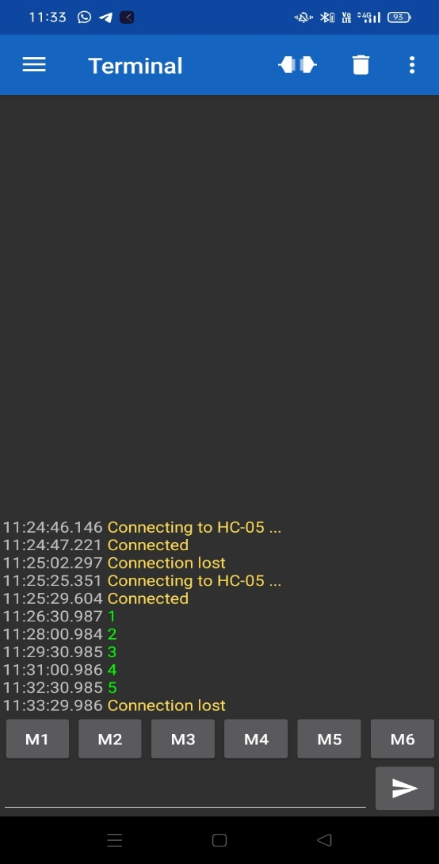
Nutan Maharashtra Vidya Prasarak Mandal’s
NUTAN COLLEGE OF ENGINEERING AND RESEARCH
Under Administrative Support of Pimpri Chinchwad Education Trust
ISO 21001:2018 EOMS Certified
Mini Project II Presentation
Result:
As shown in the screenshot, the terminal displays the cycle count in real-time. Each number represents a completed cycle, with the system accurately tracking and updating the count every 90 seconds.
The consistent and accurate cycle count displayed on the terminal confirms that the system is functioning as intended. The timely updates and alerts ensure that operators are informed immediately, allowing for efficient monitoring and management of industrial machines.
The results validate the reliability and efficiency of the Smart Industrial Machine Monitoring System. The successful implementation of real-time cycle tracking and alert notifications highlights the potential for improved operational oversight in industrial settings.

Slide 11
Nutan Maharashtra Vidya Prasarak Mandal’s
NUTAN COLLEGE OF ENGINEERING AND RESEARCH
Under Administrative Support of Pimpri Chinchwad Education Trust
ISO 21001:2018 EOMS Certified
Mini Project II Presentation
Working Time Calculation(in sec):
To calculate the total time the motor has been operating, we use the following equation:
Total Time=Number of Cycles×90seconds
Where,
Number of Cycles: The count of completed cycles as displayed on the Bluetooth terminal.
90 seconds: The fixed time interval for each cycle.
For example, if the Bluetooth terminal shows that 10 cycles have been completed, the total
operation time of the motor can be calculated as follows:
Total Time=10cycles×90seconds
Total Time=900seconds
Therefore, the motor has been operating for a total of 900 seconds.

Slide 12
Nutan Maharashtra Vidya Prasarak Mandal’s
NUTAN COLLEGE OF ENGINEERING AND RESEARCH
Under Administrative Support of Pimpri Chinchwad Education Trust
ISO 21001:2018 EOMS Certified
Mini Project II Presentation
References:
[1] Ibtesam R. K. Al-Saedi, Farag Mahel Mohammed and Saif Aldeen Saad Obaye: CNC Machine Based on Embedded Wireless and Internet of Things for Workshop Development.
[2] Yuan Guo, Yu Sun and Kai Wu: Research and development of monitoring system and data monitoring system and data acquisition of CNC machine tool in intelligent manufacturing.
[3] Amirul Syafiq Sadun, Jamaludin Jalani and Jumadi Abdul Suko: Review on smart manufacturing based on IoT: An Industrial application.
[4] D. Gowtham chitha1, S. HariBalaji, S. M. Kavi Prabu, Dr P. Karuppuswamy : A comparative study on the position control method of dc servo motor with position feedback by using Arduino.
[5] A Ajitha, J.Laxmi Prasanna , D Swathi ,D Shyamala : IoT platform for Condition Monitoring of Industrial Motors.
[6] Nikita Gosavi, Sakshi Babar, Bhagwan Katale, Prof P.H. Kulkarni: Smart Monitoring System for Industrial Automation (IoT based).
[7] Mohamed Abdulahi: Automatic System to Calculate Working Hours for Machines and Operators.
[8] Mehmet Şen and Basri Kul: IoT-Based Wireless Induction Motor Monitoring.
[9] Abhishek Gupta: Induction motor speed control using android application, I. J. of Electrical and Electronic Research.

Slide 13
Nutan Maharashtra Vidya Prasarak Mandal’s
NUTAN COLLEGE OF ENGINEERING AND RESEARCH
Under Administrative Support of Pimpri Chinchwad Education Trust
ISO 21001:2018 EOMS Certified
Mini Project II Presentation
THANK YOU!

